Slide 1
Budget Plan Project BSC Company Group 1
Prepared By: Jill Austin, Hareesh Dasari, Lakshmi Brahmani Suravajjala, Pavithra Ramkumar, Yuanming Shi

Slide 2
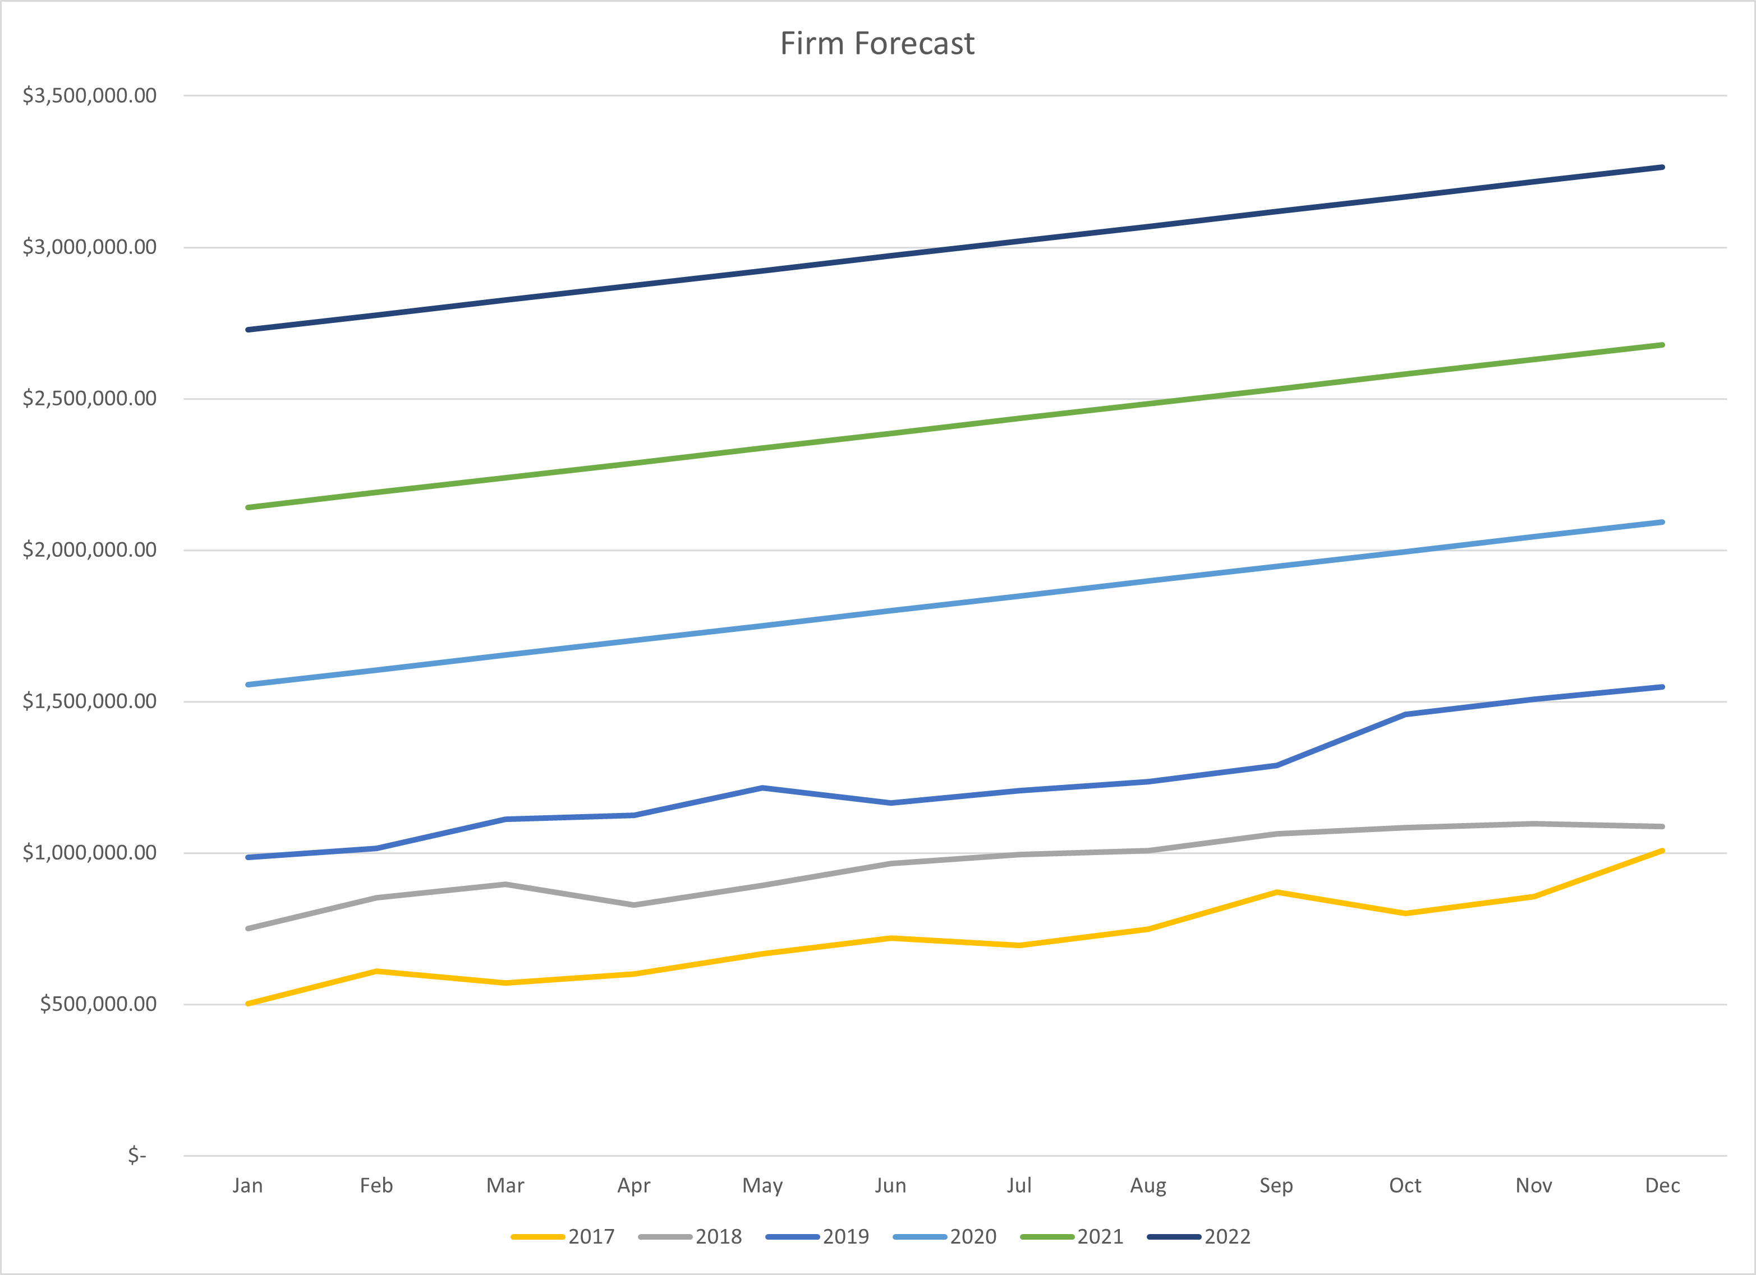

Slide 3
Revenue Budget – BSC Company
 | 2020 | 2021 | 2022
January | $ 1,555,626 | $ 2,141,572 | $ 2,727,518
February | $ 1,604,455 | $ 2,190,401 | $ 2,776,347
March | $ 1,653,284 | $ 2,239,230 | $ 2,825,176
April | $ 1,702,113 | $ 2,288,059 | $ 2,874,005
May | $ 1,750,942 | $ 2,336,888 | $ 2,922,834
June | $ 1,799,770 | $ 2,385,716 | $ 2,971,663
July | $ 1,848,599 | $ 2,434,545 | $ 3,020,491
August | $ 1,897,428 | $ 2,483,374 | $ 3,069,320
September | $ 1,946,257 | $ 2,532,203 | $ 3,118,149
October | $ 1,995,086 | $ 2,581,032 | $ 3,166,978
November | $ 2,043,915 | $ 2,629,861 | $ 3,215,807
December | $ 2,092,743 | $ 2,678,690 | $ 3,264,636
Totals | $ 21,890,217 | $ 28,921,571 | $ 35,952,924

Slide 4
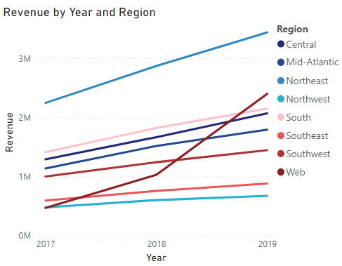
Variance Analysis: Regions
Online (web) sales had most growth year to year
Northeast highest overall

Slide 5
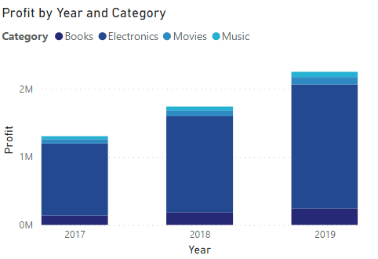
Variance Analysis: Categories
Electronics was the category with the highest profit each year

Slide 6
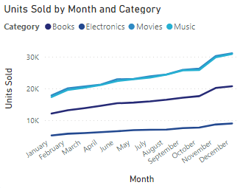
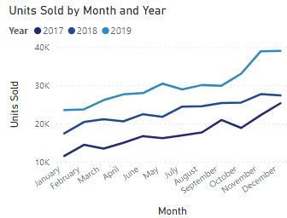
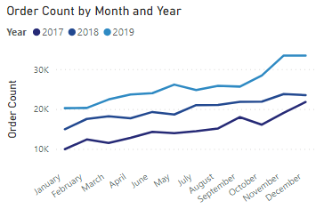
Variance Analysis: Seasonality
Holiday seasonality
Units sold, order counts, and revenue are highest in November and December across all years

Slide 7
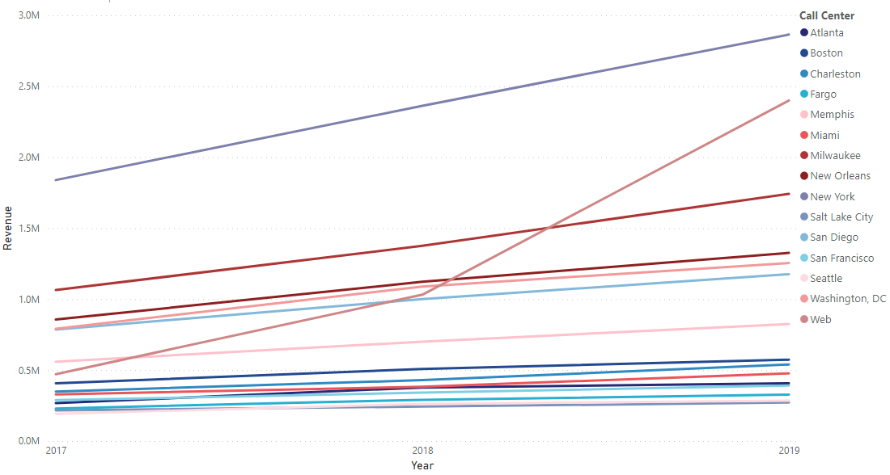
Variance Analysis: Call Center
New York and Milwaukee highest revenue
Web shows the most growth year over year

Slide 8
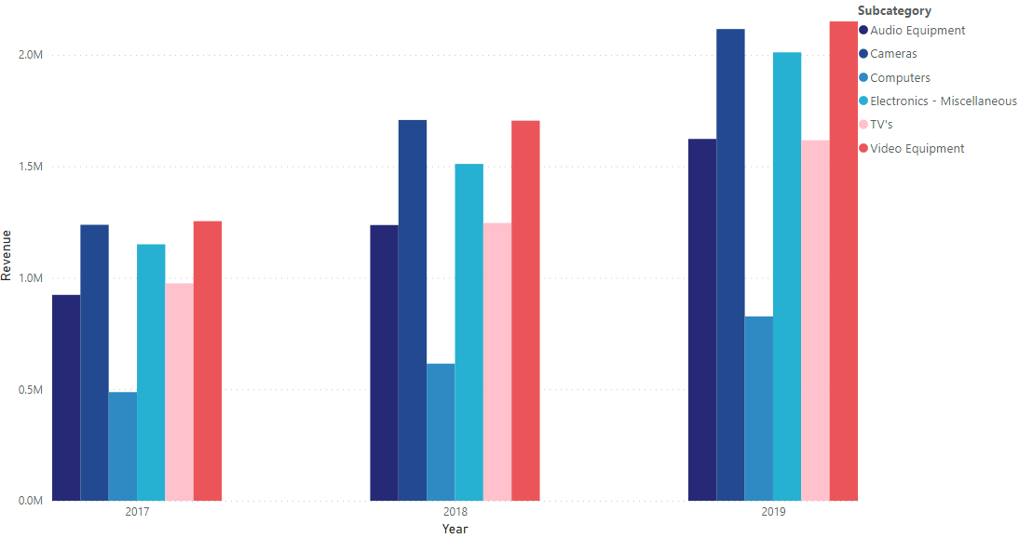
Growth: New Products
Top three subcategories include:
Video equipment
Cameras
Miscellaneous

Slide 9
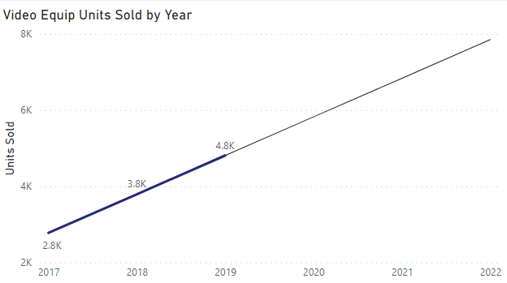
Unit Targets: Video Equipment
Year | Unit Targets
2020 | 5,824
2021 | 6,839
2022 | 7,854

Slide 10
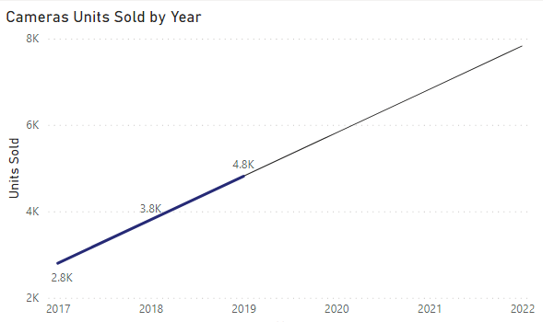
Unit Targets: Cameras
Year | Unit Targets
2020 | 5,819
2021 | 6,825
2022 | 7,831

Slide 11
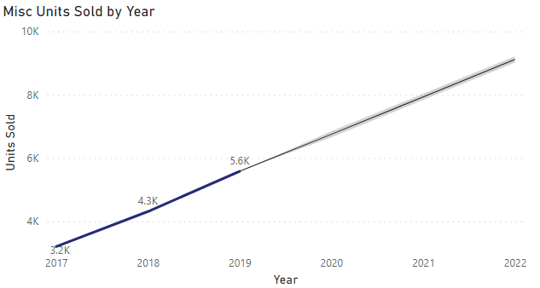
Unit Targets: Misc Electronics
Year | Unit Targets
2020 | 6,751
2021 | 7,933
2022 | 9,115

Slide 12
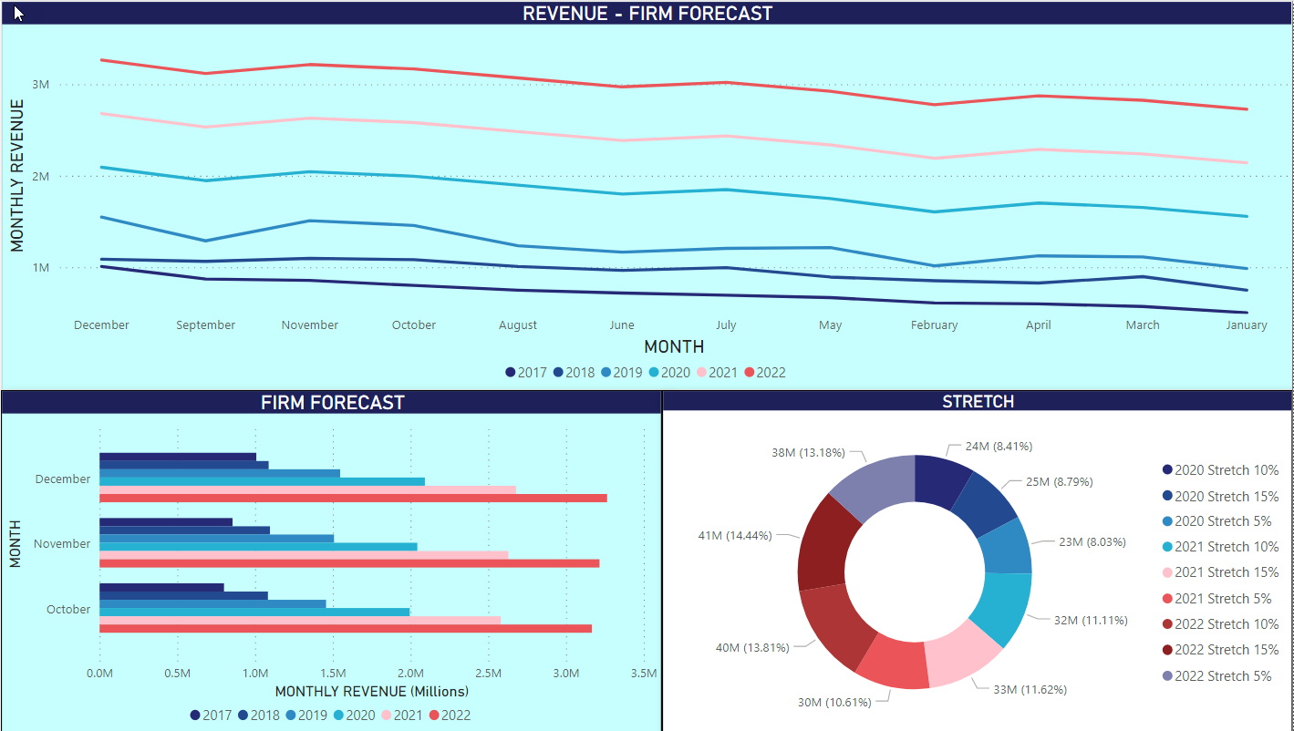

Slide 13
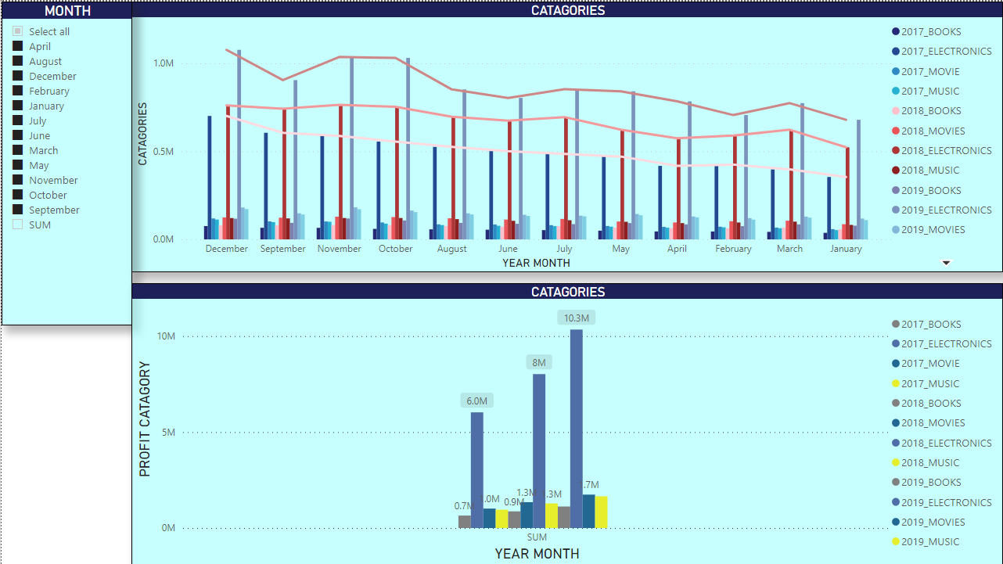

Slide 14
Conclusion & Q/A

